Slide 1



Технологии машинного обучения Machine learning technologies
Lecture 2 – Data preprocessing and feature engineering
Peter Gladilin, Assistant Professor
ITMO University

Slide 2
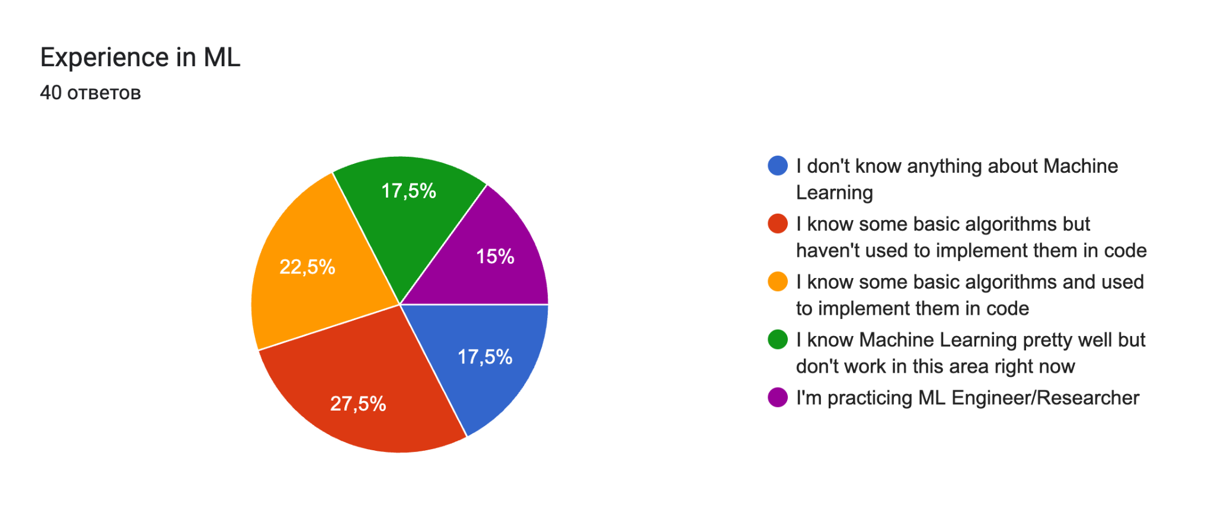
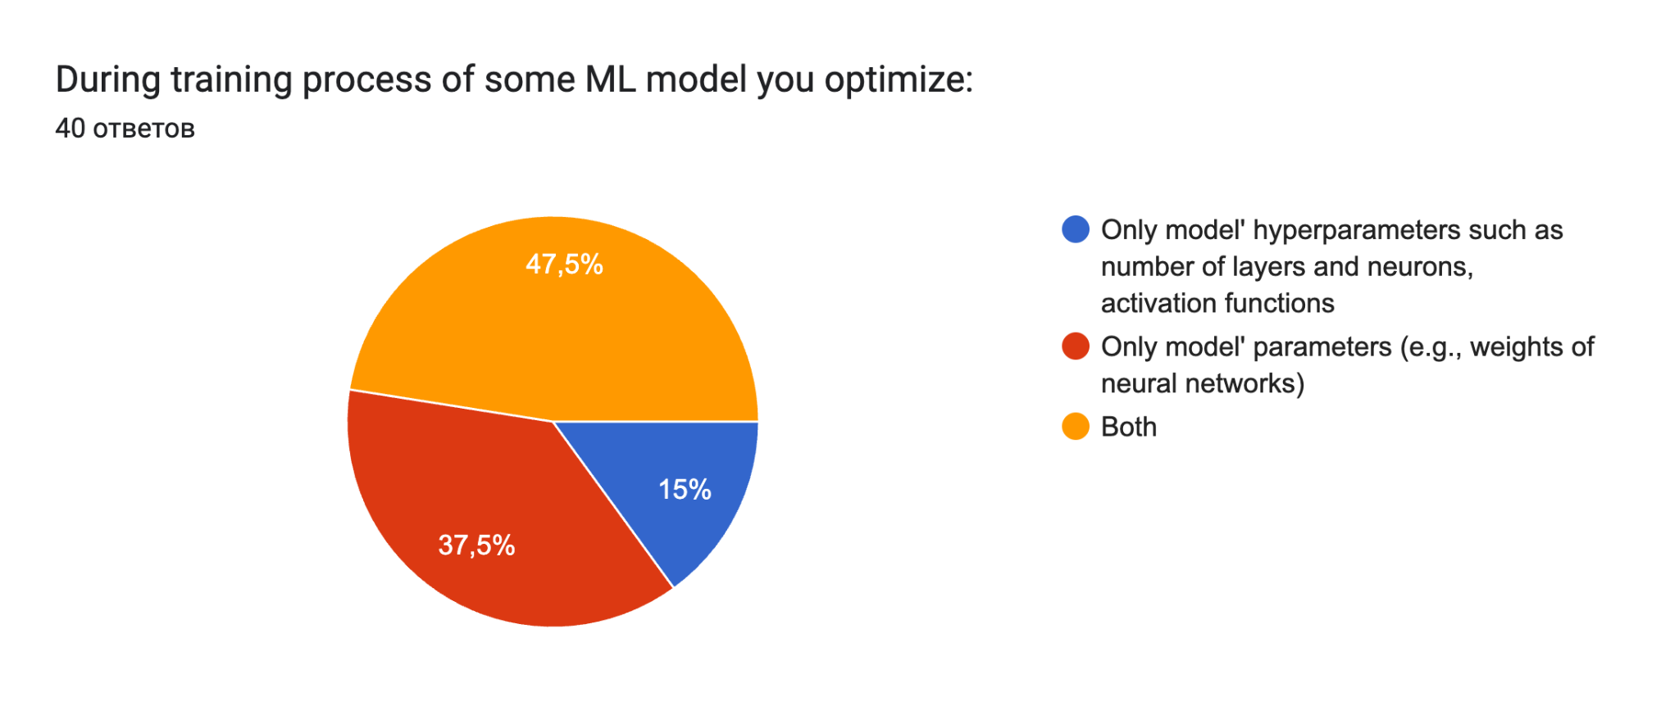
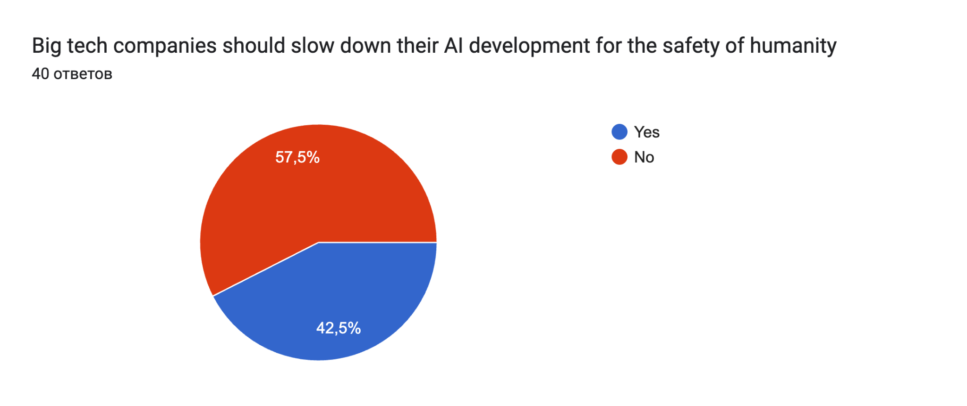
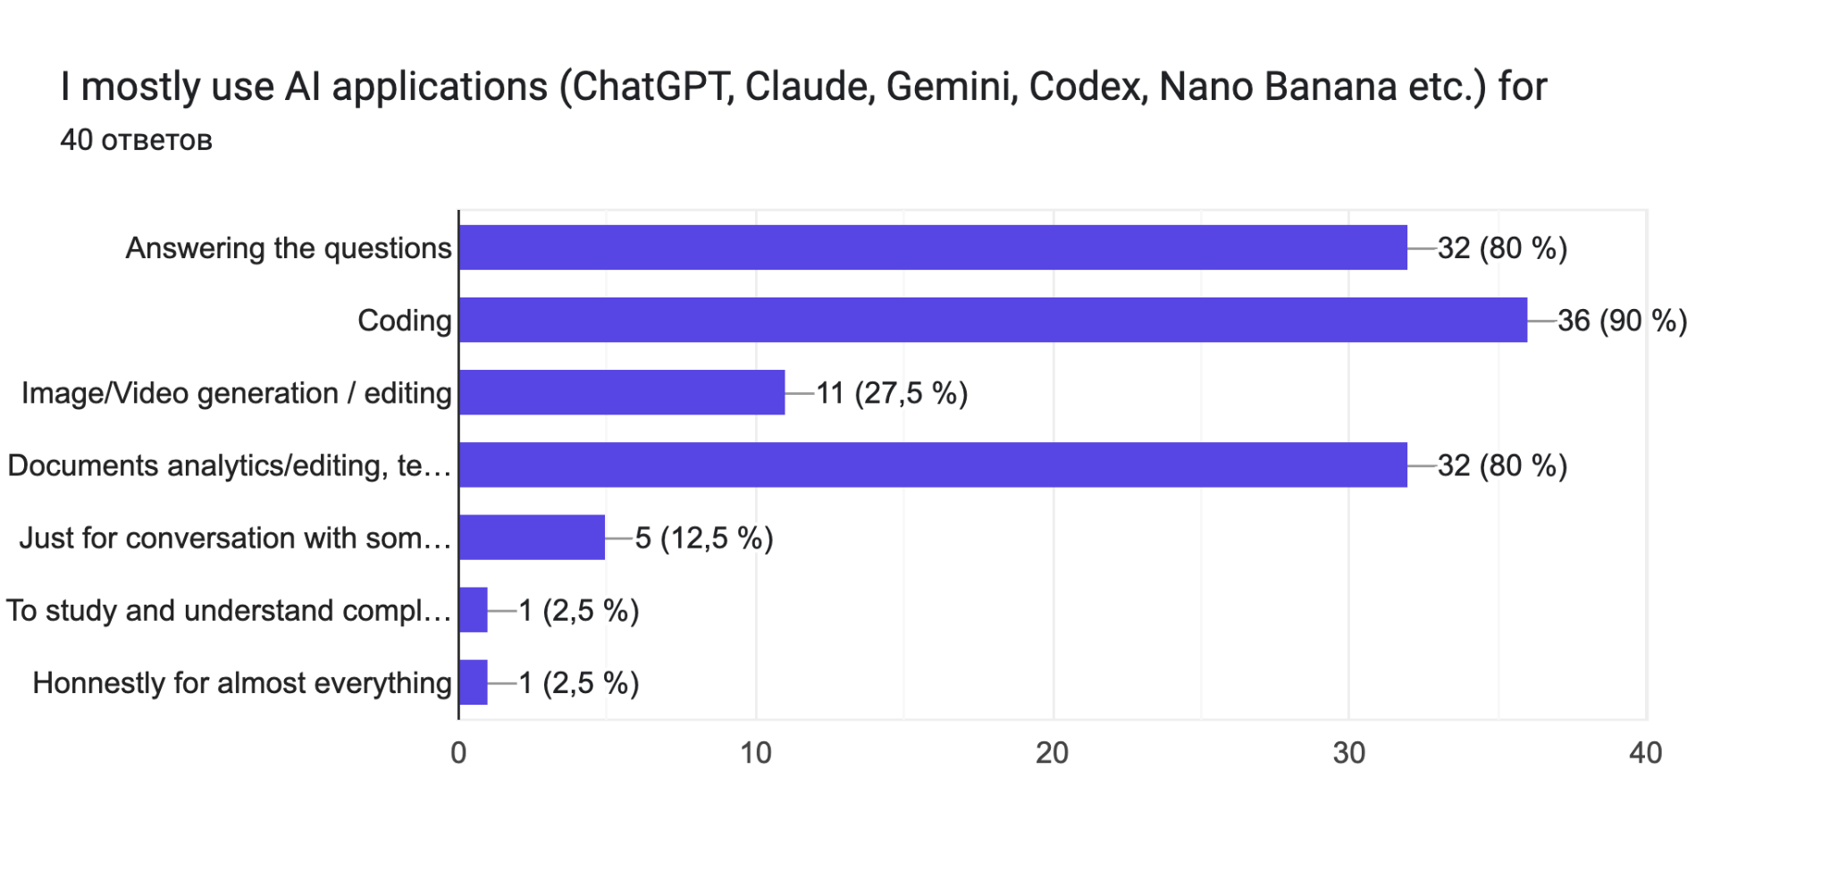
Survey results

Slide 3
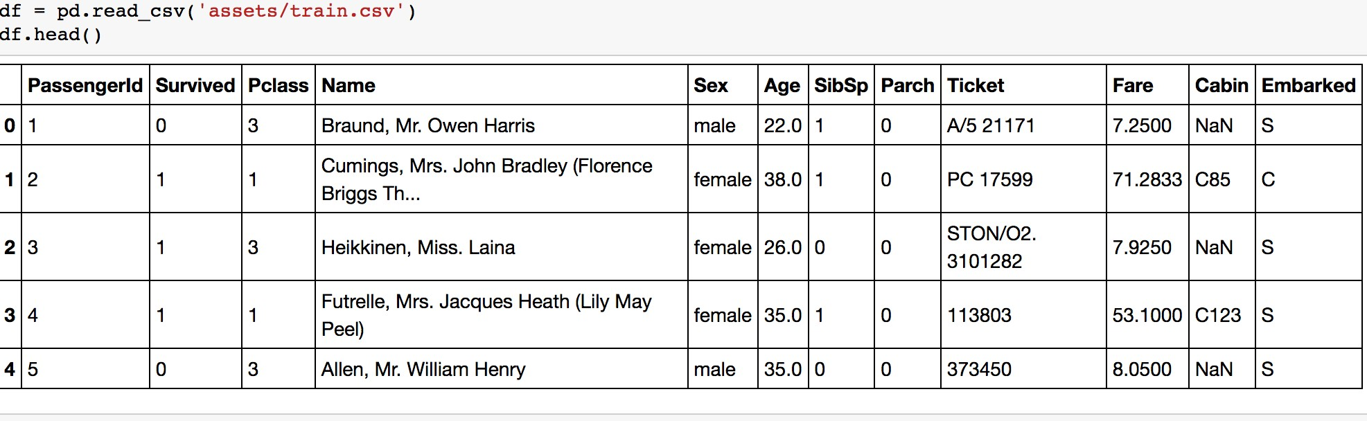





Data, features, labels etc.
object
label
features
dataset

Slide 4
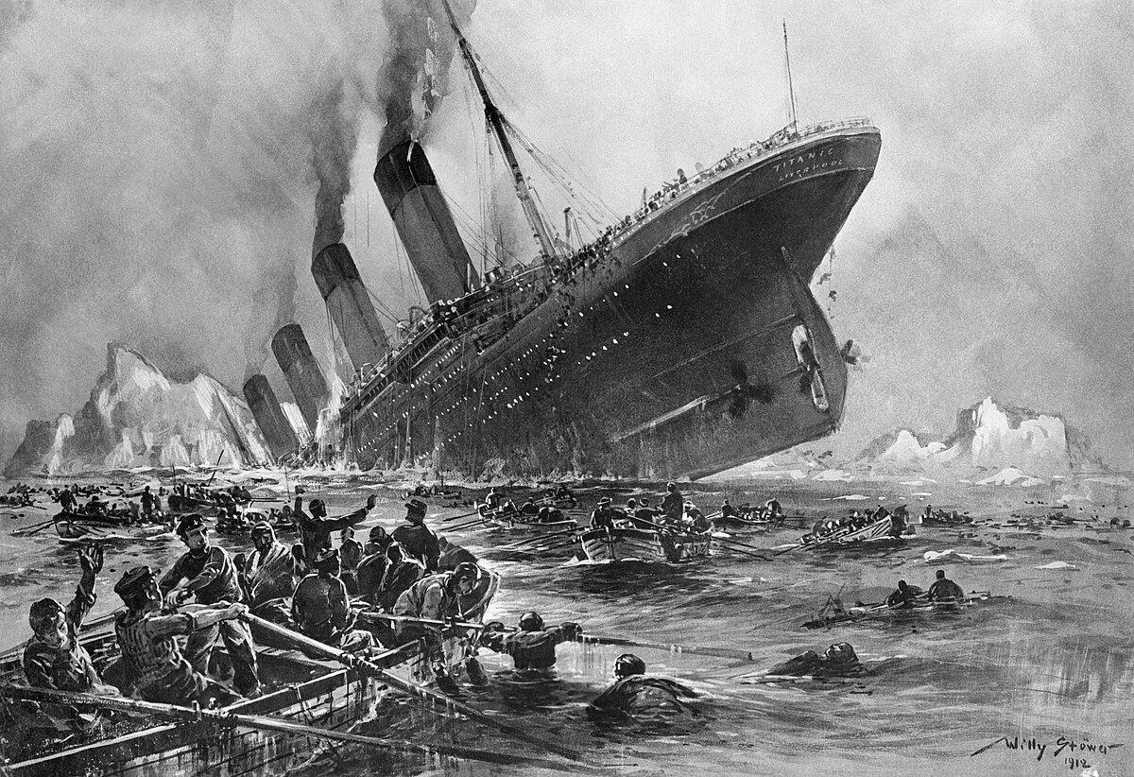
Titanic disaster - 1912
Titanic sank on 15 April 1912 in the North Atlantic Ocean. The largest ocean liner in service at the time, Titanic was four days into its maiden voyage from Southampton England, (incl. Cherbourg and Queenstown) to New York City, United States, with an estimated 2,224 people on board when it struck an iceberg at 23:40 (ship's time) on 14 April.
It sank two hours and forty minutes later at 02:20 ship's time (05:18 GMT) on 15 April, resulting in the deaths of up to 1,635 people, making it one of the deadliest peacetime maritime disasters in history…
https://en.wikipedia.org/wiki/Sinking_of_the_Titanic

Slide 5
Data preprocessing and feature engineering

Slide 6
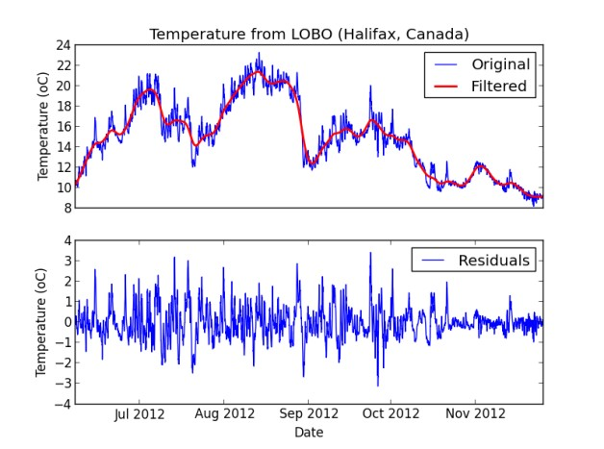
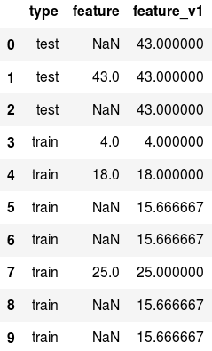
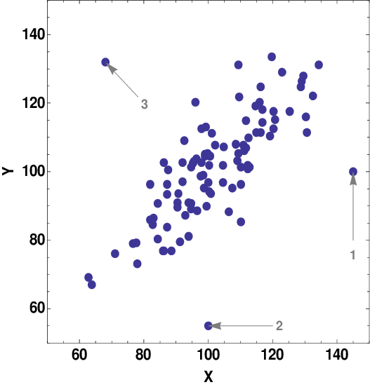
Data preprocessing
Tasks:
Common problems with raw data:
cleaning;
formatting;
scaling / normalization;
processing of categorical features…etc.
NaN-s;
outliers,
non-standard formatting;
noise.
outliers
noise
NaNs

Slide 7
Data preprocessing
Non-standardized formatting use-cases:
‘SpB’, ‘spb’, ‘SPB’, ‘Spetersburg’, ‘S-Petersburg’, ‘sptrsbrg’, ‘Saint-Petersburg’, ‘spb’, ‘Питер’, ‘СПб’, ‘Санкт-петербург’, ‘С.-Петербург’
Saint-Petersburg
08.07.2024, 08.07.24, 08-07-24, 08//07//24, 07/08/2024, 08-07-2024,
2024-08-07, 08Jul2024, 8 JULY 2024, 2024 july 08, 8 июля 2024 года, 8 июля 24 г.
08.07.2024

Slide 8
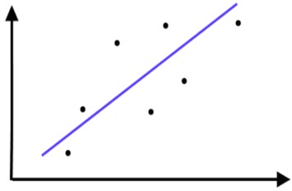

Methods for handling outliers and missing data
Missing data can be handled in different ways depending on their number relative to the size of the entire data sample:
- if there are few gaps, you can delete objects with gaps;
- if there are many gaps in important features, you can fill in the gaps with the mean, median or neighboring value, the majority class (for categorical variables);
Outliers / NaNs in data can be:
filled in (e.g. mean, median or majority class);
deleted.
You should choose the most appropriate way of handling missing data by yourself in every particular case
Outlier is the measurement result that stands out from the general distribution of the data.
The following outlier test is sometimes performed using a supervised model:
Exclude the i-th point
Evaluate the model on data without the i-th point.
If the quality of the adjusted model was changed a lot, then i - is an outlier.
The outlier test separates outlier results from the results of which the residuals are large, but the value of which is suitable for the selected model.
Special algorithms for estimating distribution’s density (like DBSCAN) or other statistical techniques can be applied for this tasks (e.g., “3-sigma rule”)
Y
error is the difference between real and predicted values
X

Slide 9
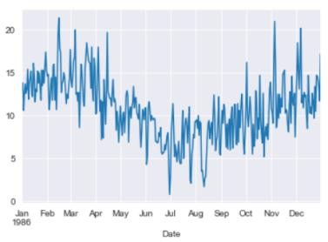
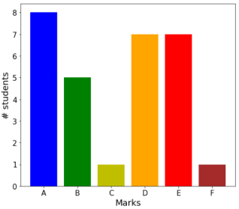
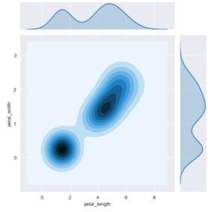
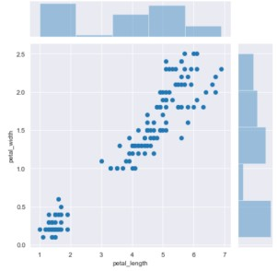
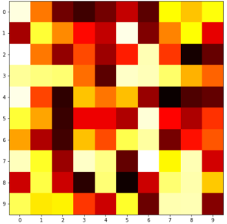
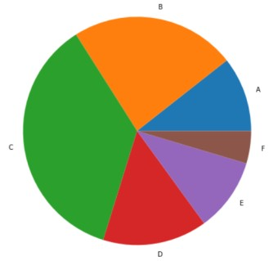
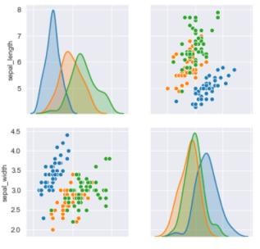
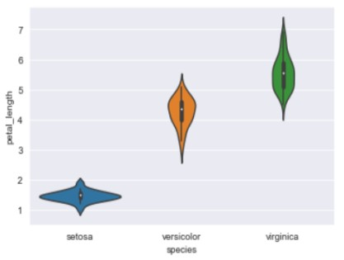
Data vizualization - matters!
Matplotlib is a standard Python data visualization library; The matplotlib.pyplot module provides a high-level library interface for plotting various types of plots.
The Seaborn library is an installable matplotlib add-on that provides tools for more attractive graph display;
convenient work with objects of the pandas package;
building new types of graphic objects.
1D curve (x-y)
histogram
2D clouds with projections
scatter-plot+ histogram
heatmap
pieplot
scatter-plot-matrix
violin-plot

Slide 10
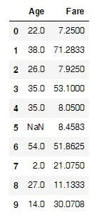
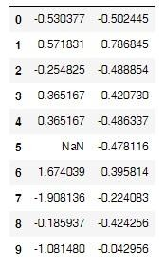
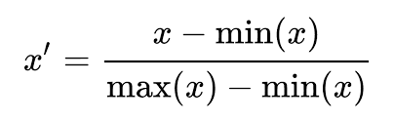
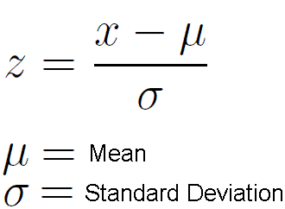
Scaling and stanardization
Standardization:
Data transformation f(x) (where f is a measurable, usually continuous function) such that the transformed data becomes (approximately) normally distributed. for example, logarithm or power transformations of data (Box-Cox, etc.)
Example of Z-scaling:
Scaling:
Data transformation f(x) = cx + b, c ∈ R, that is, multiplying the feature values by a constant c that changes the scale (for example, from nanometers to kilometers) and adding (optionally) bias b.
In practice, the following transformations are most often applied:
MiniMax scaling:
z-scaling:
sklearn.preprocessing.MinMaxScaler()
sklearn.preprocessing.StandardScaler()

Slide 11
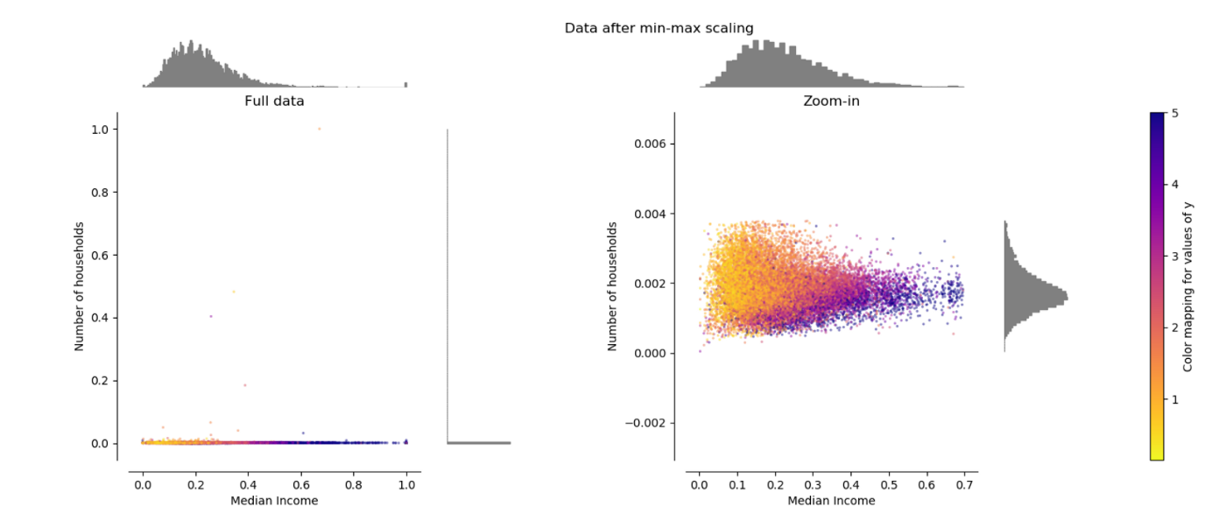
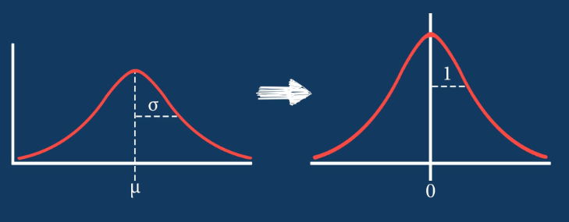
Scaling
MiniMax scaling:
When Do We Need Feature z-scaling?
Using distance-based algorithms: Models like K-Nearest Neighbors (KNN), K-Means Clustering, and Support Vector Machines (SVM)
Training with gradient descent (numerical stability)
Applying regularization: (L1 and L2)
Data has outliers
When Min-Max is more appropriate:
You need exact bounded ranges (e.g., in image/video processing)
Keep the data sparse (0’s transform to 0’s for a non-negative data)
When it’s better to make features normally distributed?
Algorithms That Prefer or Require Normality (LDA, Linear Regression/Logistic Regression)
When the distribution has huge tails
z-scaling:

Slide 12
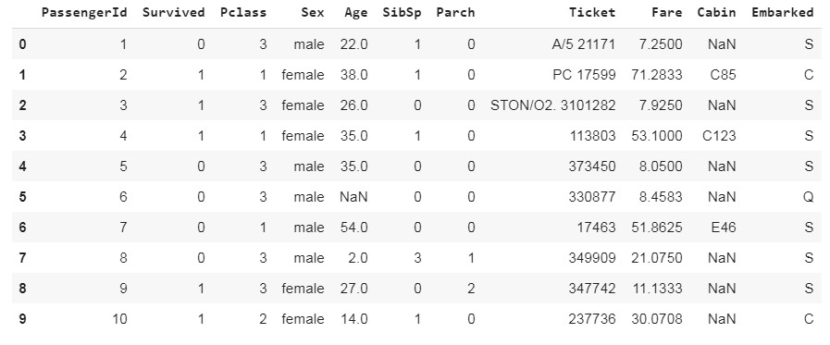
Feature types
Various types of features
Among the tabular data, numerical, categorical and logical
variables are distinguished;
For categorical features where no ordinal relationship exists, integer encoding (so called, “Label Encoding”) can lead to unexpected results!
to add categorical features (for example, “color”, “relationship”, “weather”) to the model, it is necessary to be able to correctly process them algorithmically.
It is often impossible (incorrectly) to introduce an ordering
relation into such variables (the “LabelEncoding” method);
the "One-Hot-Encoding" method is applied, which assigns a binary vector to each value of a categorical feature from 1 to the position corresponding to the value of this feature and 0 to all others.
There is a wide variety of functions for handling categorical variables in machine learning frameworks.
Color
red
blue
green
blue
green
red | green | blue
1 | 0 | 0
0 | 0 | 1
0 | 1 | 0
0 | 0 | 1
0 | 1 | 0
one-hot-encoding

Slide 13
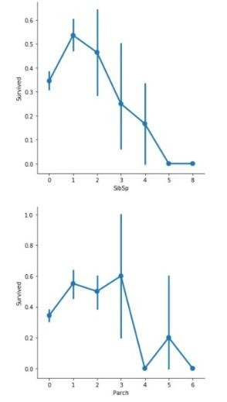
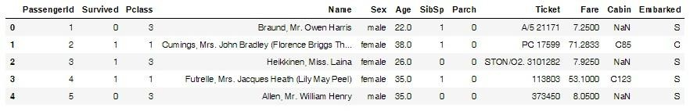
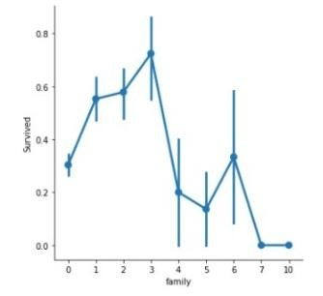
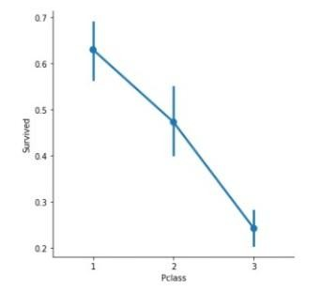
Factor and discriminative analysis
Factor analysis:
reduction in the number of features (data reduction);
determination of relationships between features
transformation of features.
Discriminative Analysis:
determining the significance of features for predicting the target variable;
reduction of the number of features for optimal tuning of the predictive model.
Number of brothers/sisters
+
can be removed, since the target variable does not
depend on these features
Synthetic feature “family”
"Cabin class": the higher the class, the more likely it is to be saved
Number of parents/child

Slide 14
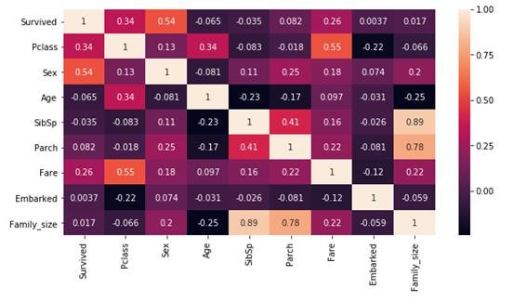
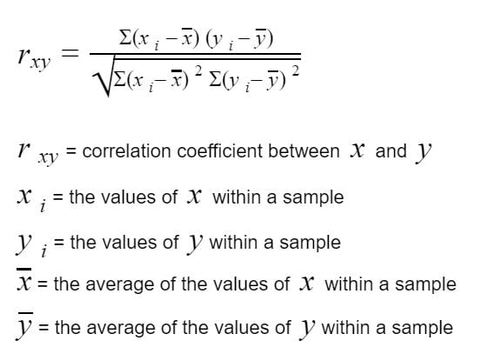
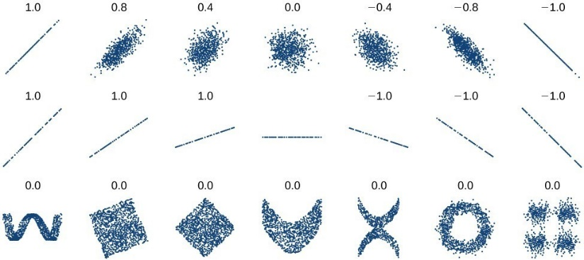
Correlation analysis
Correlation is the statistical relationship between two or more random variables.
Titanic survivors Feature correlation heatmap
Pearson's correlation coefficient characterizes the existence of a linear relationship between two quantities:
covariance of 2 variables
std’s of X and Y
To identify not only a linear relationship between the variables, instead of the Pearson's correlation coefficient, the Spearman's rank correlation coefficient is used, which makes it possible to track more complex relationships between the variables.
Highly correlated features may led to instability and not appropriate results especially for linear models

Slide 15
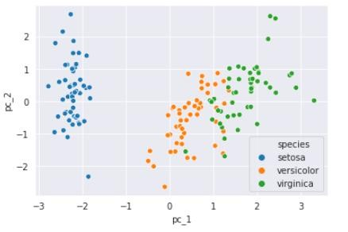
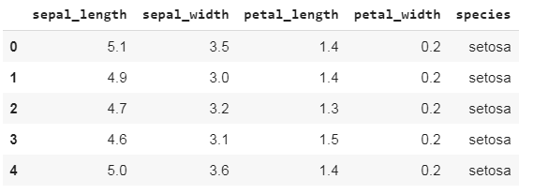
Dimension reduction
Dimension reduction is data transformation that consists in reducing the number of features by obtaining the most important features.
Principal component analysis (PCA) maps data linearly to a smaller dimension in such a way that the variance of the data in the smaller representation is maximized.
Goal:
reduction in computational costs;
fight against overfitting;
data compression;
data visualization.
2D representation after PCA
Iris Dataset:

Slide 16
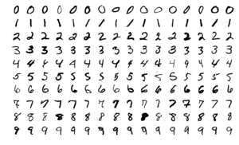



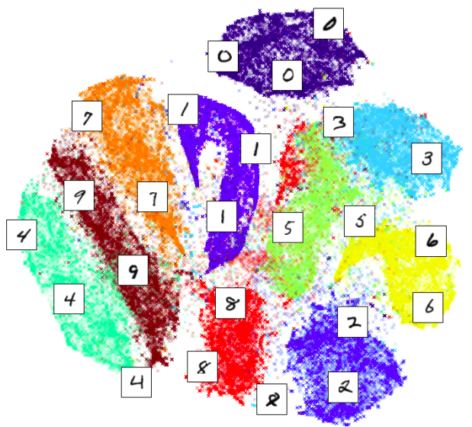
Nonlinear dimension reduction method t-SNE
t-SNE: “stochastic embedding of neighbors with t-distribution”.
given a set of N high-dimensional objects, t-SNE first computes the probabilities p_{ij}, which are proportional to the similarity of the objects x_{i} and x_{j} as follows:
An example of visualization of handwritten digits MNIST using the t-SNE method:
the t-SNE algorithm seeks to obtain a mapping of Y into a d-dimensional space that reflects the similarities p_{ij} as much as possible. To do this, the algorithm measures the similarity q between two points y_{i} и y_{j}:
the locations of the points y_{i} in low-dimensional space are determined by minimizing the Kullback - Leibler distance of the distribution Q from the distribution P;
perplexity parameter: the number of points to keep the distance to in low- dimensional space.

Slide 17
Summary
Data preprocessing:
cleaning
formatting
scaling/normalizing
filling the gaps
categorical features processing
Factor and discriminative analysis:
dimension reduction
feature engineering
correlation analysis

